Slide 1
Distributed Network Programming
Prativa Nyaupane

Slide 2
Review
Socket Programming using TCP and UDP

Slide 3
Outline
TCP
UDP
IP Address
Ports
Socket Programming using TCP and UDP
Working with URLs and URL Connection Class
Email Handling using Java Mail API
Architecture of RMI
Creating and Executing RMI applications
Architecture of CORBA
RMI vs CORBA
IDL and Simple CORBA Program

Slide 4
Creating own Server and Client in Java Contd…
The client application creates a socket object and specifies the server’s IP address and port number to establish a connection.
Both the server and client applications can use input and output streams associated with the Socket object to send and reciev data.
Communication between the server and client can be done using various protocols, such as TCP or UDP.

Slide 5
Networking Classes in Java
Java provides a set of built in classes required for creating own server and client:
First of all, we should import java.net package
Networking classes in Java : Socket, ServerSocket
Client-side endpoint(Socket) | Server-side endpoint(Server Socket)
It establishes a TCP connection to a remote server. | It is used to listen for incoming client connections in a specific port.
It also provides input and output stream for sending and receiving data. | It can accept client connections using accept() method and create a separate Socket objects
Once a client connection is accepted, a new Socket object is created on the server side to communicate with the client.

Slide 6
Networking Classes in Java
The other networking classes are:
URL : In Java, the URL class represents a URL and provides functionalities to parse, construct, and work with its various components.
URLConnection : In Java, the URLConnection class serves as a bridge between a URL and the actual network connection.
InetAddress : It acts as a bridge between human-readable hostnames (like "pu.edu.np") and numerical IP addresses.

Slide 7
Creating own Server and Client in Java Contd…
Java socket programming is used for communication between the applications running on different JRE.
In Java, we can create our own Server and Client applications using the ServerSocket and Socket classes.
The Server application typically listens on a specific port using a ServerSocket object. It accepts incoming client connections using the accept() method of the server socket class.
Once a client connection is accepted, a new Socket object is created on the Server side to communication with the client.

Slide 8
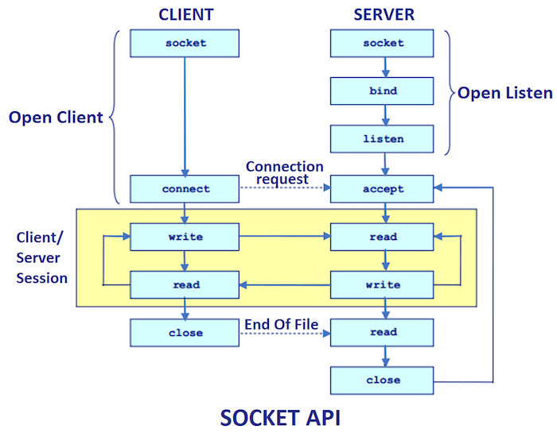
Establish a Socket Connection:
To enable communication between two machines there must be socket present at both endpoints.
Each socket must be assigned with IP address and port number.
After creation of socket, the bind function binds the socket to the address and port number.
listen(): It puts the server socket in a passive mode, where it waits for the client to approach the server to make a connection.
accept(): This method waits for the client. If client connects with the given port number, it returns an instance of a Socket

Slide 9
After the connection is established…
2. Communication in Client/Server:
In the figure, client will first write to the server i.e send data to the server.
To write data: DataOutputStream Class is used.
Server will then read the data ie. receive the data.
To read data: DataInputStream Class is used.
The new socket object maintains direct communication, hence, we can write and read messages to and from the server.
3. Closing the Connection:
Finally, once the purpose is fulfilled the client sends a request to the server to terminate the connection between the client socket and server socket.

Slide 10
DataOutputStream
A data output stream lets an application write primitive Java data types to an output stream in a portable way.
To use this, first import
import java.io.*;
When we want to send data over a network connection, we use SocketOutputStream.
OutputStream outputStream =clientSocket.getOutputStream();
We then pass the OutputStream to DataOutputStream, because DataOutputStream so that we can add primitive data type to the socket’s output stream.
Socket clientSocket = new Socket("localHost" ,6666);
OutputStream outputStream =clientSocket.getOutputStream();
DataOutputStream dataOutputStream = new DataOutputStream(outputStream );
dataOutputStream.writeUTF("Hello!");
dataOutputStream.flush();
dataOutputStream.close();
clientSocket.close();

Slide 11
DataOutputStream Contd…
writeUTF(“Hello”) - writes String to the DataOutputStream.
flush() - flush() makes sure any buffered data is written to the output stream.
close() - It is important to close output stream to free up the resources and ensure proper cleanup.

Slide 12
DataInputStream
InputStream inputStream = clientSocket.getInputStream();
DataInputStream dataInputStream = new DataInputStream(inputStream);
String stringFromInputStream = (String) dataInputStream.readUTF();
Java DataInputStream allows an application to read primitive data from the input stream in a machine-independent way.
InputStream is used to read data from a source into a java program.
DataInputStream is wrapped around Socket’s InputStream so that the client/server can read primitive data types sent over the network using DataOutputStream.
readUTF - reads a String thats stored in a modified UTF-8 format from the inputstream.

Slide 13
Create a TCP client server application where the client sends a string and the server responds by echoing the same string in uppercase

Slide 14
import java.io.*;
import java.net.*;
import java.util.Scanner;
public class TCPClient {
public static void main(String[] args) {
try {
Socket socket = new Socket("locahost", 1234);
DataOutputStream out = new DataOutputStream(socket.getOutputStream());//pass data between //two applications
out.writeUTF(“Hello!”);//write string in a network-compatible way
out.flush(); //force buffered data to the output stream
out.close(); //free up the resource
// Receive and print the response from the server
DataInputStream in = new DataInputStream(socket.getInputStream());
String response = in.readUTF();
System.out.println("Server response: " + response);
socket.close();
} catch (IOException e) {
e.printStackTrace();
}
}
}

Slide 15
import java.io.*;
import java.net.*;
public class TCPServer {
public static void main(String[] args) {
final int PORT = 1234;
try {
ServerSocket serverSocket = new ServerSocket(PORT); //Server is started and listening in 1234 //port
Socket clientSocket = serverSocket.accept(); //client is connected to server
DataInputStream in = new DataInputStream(clientSocket.getInputStream());//get data from client
// Receive the string from the client
String receivedString = in.readUTF(); //read client’s data
System.out.println("Received from client: " + receivedString);
DataOutputStream out = new DataOutputStream(clientSocket.getOutputStream());
// Echo back the received string in uppercase
String upperCaseString = receivedString.toUpperCase();
out.writeUTF(upperCaseString);
out.flush();
out.close();
clientSocket.close();
serverSocket.close(); // Close the server socket after processing one client
} catch (IOException e) {
e.printStackTrace();
} }}

Slide 16
Past Questions
Create a TCP client server application where the client sends a string and the server responds by echoing the same string in uppercase
Write a Java program that send messages with each other using TCP socket.
Write a program to send “Message from Pokhara University” from client to server using java socket programming.
Create a TCP client/server program in which multiple user can send and receive message from each other
TCP vs UDP

